Slide 1
AWS Budgets: Managing Costs Efficiently
A guide to setting, monitoring, and optimizing AWS Budgets

Slide 2
Introduction to AWS Budgets
AWS Budgets help businesses set and track cost and usage limits.

Slide 3
AWS Budgets vs AWS Cost Explorer
AWS Budgets: Controls costs with alerts
AWS Cost Explorer: Analyzes spending patterns

Slide 4
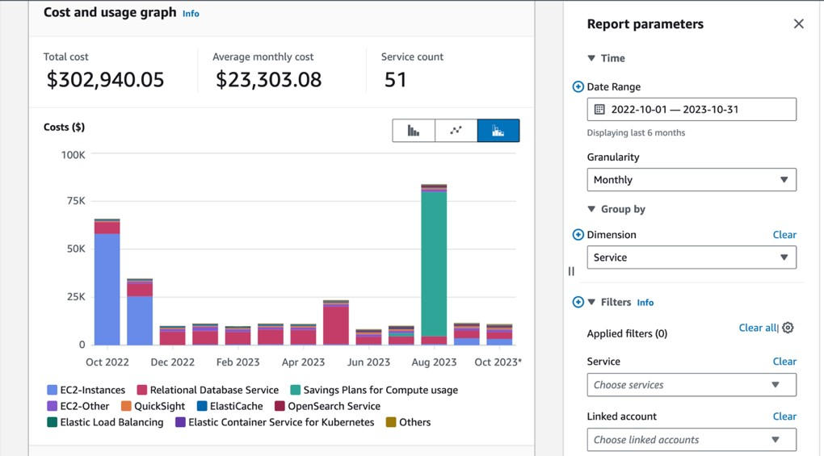
Cost explorer

Slide 5
Types of AWS Budgets
Cost Budget
Usage Budget
RI & Savings Plans Budget

Slide 6
How to Create an AWS Budget
1. Open AWS Cost Management Console
2. Select AWS Budgets
3. Create Budget
4. Set Alerts

Slide 7
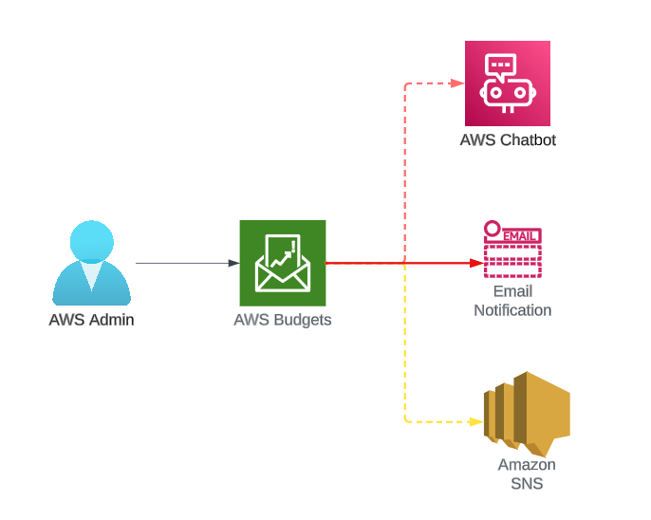
How it works??

Slide 8
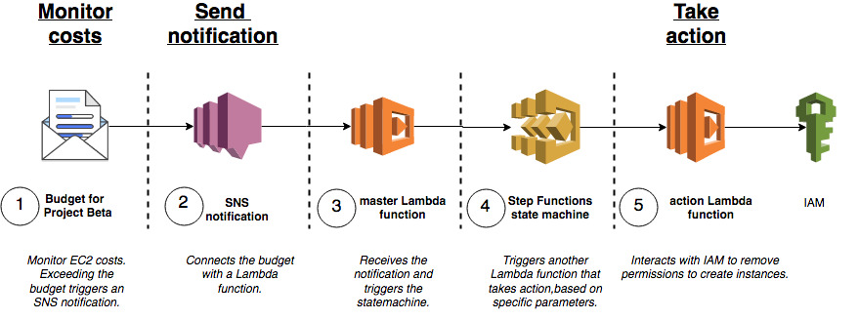
Architecture

Slide 9
The budget for “Project Beta” is set up in AWS Budgets. In this example, we focus on EC2 usage and identify the instances that belong to this project
The budget configuration also includes settings to send a notification on an SNS topic when the usage exceeds 100% of the budgeted amount.
The master Lambda function receives the SNS notification.
lambda function triggers execution of a Step Functions state machine to handle the situation. Step function can pass data along each step and make decisions
After the step functions workflow decides on the remedy, it invokes another Lambda function . The function interacts with IAM to effectively remove the user’s permissions to create an EC2 instance.
So that businesses save money and ensure to stay within budget.

Slide 10
AWS Budgets Dashboard Overview
Dashboard shows budget summary, actual vs forecasted spend, and alerts configuration.

Slide 11
AWS Budgets with AWS Organizations
Set budgets across multiple AWS accounts using consolidated billing.

Slide 12
AWS Budgets & Cost Optimization Best Practices
Use RI & Savings Plans
Enable Auto Scaling
Identify underutilized resources

Slide 13
Case Study – AWS Budgets in Action
Delhivery achieved 15% cost savings on its cloud infrastructure in just 50 days by utilising cost and usage reports.

Slide 14
Common AWS Budgets Mistakes & How to Avoid Them
Not setting alerts
Ignoring Reserved Instances
Not reviewing budgets regularly

Slide 15
Conclusion
One can achieve cost efficiency by wisely implementing AWS tools namely Budgets and Cost explorer.

Slide 16
Thank you
Any questions

